Slide 1


Reasoning with Food Knowledge Graphs
Tracing the Journey from Soil Health to Human Health
Nilesh Gupta
(25CS60R64)
Guide: Prof. Partha Pratim Chakrabarti
Department of Computer Science and Engineering
Indian Institute of Technology, Kharagpur

Slide 2
Table of Contents
Motivation
Literature Review
Problem statement
Objective
Methodology
Work Done
Results
Papers Processed & Tools used
Plan of work for next semester
Conclusion

Slide 3
Motivation
Agriculture & Health
Agriculture directly impacts human health through nutrition, contaminants, and food safety
Fragmented Research
Existing systems treat agriculture and health as separate domains, no unified system connects soil to disease outcomes
Hidden Causal Chains
Connections like Monoculture → Fusarium → Mycotoxins → Cancer are buried across hundreds of research papers

Slide 4
Motivation (cont)
Why a Knowledge Graph?
Automatically discovers cross-domain connections from large scientific corpora
Enables multi-hop reasoning: Soil Condition → Crop → Nutrient → Human Disease
Scales with new research papers without manual curation
Real-World Relevance
Food Security
Public health policy
Precision Agriculture
Disease Surveillance

Slide 5
Literature Review
Domain | Existing Tools / Ontologies | Key Gap
Agricultural KGs | AgrOnt, FOODON, AgroLD | Focus on crop classification only — no bridge to human health
NLP Extraction | OpenIE, REBEL, GPT, Gemma | Lack domain-specific validation for agriculture-health triples
Health Ontologies | SNOMED, Disease Ontology | Medical-only — disconnected from agricultural knowledge
Critical Gap
No existing system builds an end-to-end pipeline from agricultural PDFs to a reasoning-capable knowledge graph that traces soil → crop → nutrient → human disease.
4 / 18

Slide 6
Problem Statement
Scientific literature on agriculture and health is fragmented across domains, hundreds of disconnected papers.
No automated system exists to extract structured knowledge from agricultural PDFs and reason over it.
Discovering causal chains linking soil / climate / farming practices to human diseases requires manual expert analysis.
Manual analysis of cross-domain connections is infeasible at scale as the corpus grows.

Slide 7
Research Objective
Our Objective is to design an automated pipeline that extracts structured knowledge from agricultural research literature to construct a cumulative knowledge graph. This graph will connect soil health, farming practices, crop diseases, and climate factors to human health outcomes. Using LLM-based extraction, schema-validated graph construction, and multi-hop reasoning, the system will discover hidden causal chains that emerge only when knowledge from multiple sources is linked.

Slide 8
Methodology: Pipeline Architecture
Stage 1
Stage 2
Stage 3
Stage 4
Tuple Extraction
Validation &
Deduplication
Graph Construction
Multi-hop
Reasoning
ChatGPT-5 processes PDFs → 6-tuple output
(subject, relation, object, entity_types, confidence, source)
Python: VALID_RULES + confidence ≥ 0.7
Entity normalization via controlled vocabulary
NetworkX DiGraph
Forward + reverse edges → GraphML export
Path traversal ≤ 6 hops
Partial path stitching for longer chains

Slide 9
Methodology: Entity & Relations Types
7 ENTITY TYPES
8 RELATION TYPES
CROP
NUTRIENT
CLIMATE-FACTOR
AGRICULTURE-PRACTICE
HUMAN-DISEASE
SOIL-CONDITION
PLANT-DISEASE
AFFECTS
HAS_NUTRIENT
CAUSES
LEADS_TO
ASSOCIATED_WITH
INCREASES
DEFICIENCY_CAUSES
REDUCES

Slide 10
Work Done: Data Processing & Extraction Results
KNOWLEDGE GRAPH GROWTH
EXTRACTION VALIDATION METRICS
Checkpoint
Nodes
Edges
Paths
Source Paper
Raw
Valid
Rate
After PDF 1
52
92
6
Crop Health
64
46
72%
After PDF 2
93
168
27
Soil Health
69
39
57%
After PDF 3
151
292
607
Organic Agriculture
68
65
96%
After PDF 4
189
358
1077
Agriculture & Health
63
36
57%
After PDF 5
211
412
1141
Rice False Smut
55
27
49%
Total
319
213
67%

Slide 11
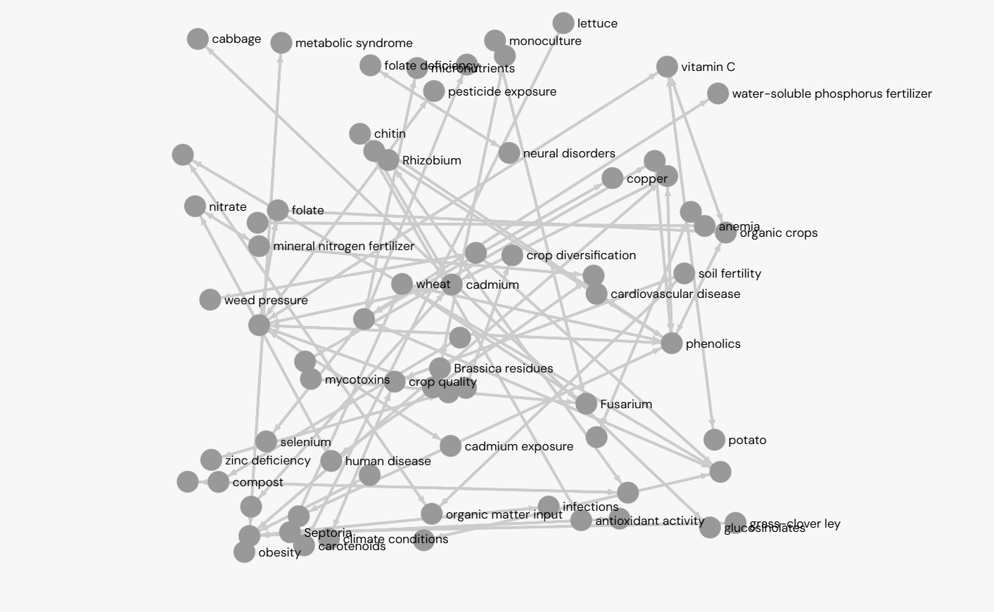
Work Done: Snapshot

Slide 12
Work Done: Master Knowledge Graph Statistics
GRAPH SUMMARY
Total Nodes — 211 | Total Edges — 412 | Multi-hop Paths — 1,141
Disease Targets — 28 unique | Max Path Length — 6 hops
PATHS TO KEY DISEASE TARGETS
1. Cancer (60 paths)
2. Cardiovascular Disease (42 paths)
3. Type-2 Diabetes (42 paths)
4. Kidney Damage (28 paths)
5. Malnutrition (13 paths)
6. Malaria (10 paths)
7. Anemia (5 paths)
0
10
20
30
40
50
60
70

Slide 13
Results: Discovered Reasoning Chains
Monoculture → Fusarium → Mycotoxins → Human Disease
Organic Farming → Reduces Cadmium → Prevents Kidney Damage
Mineral NPK Fertilizer → Increases Cadmium → Causes Cancer
Crop Rotation → Reduces Plant Disease → Reduces Economic Loss
Water Stress → Causes Plant Disease → Leads to Economic Loss
Organic Farming → Increases Phenolics → Reduces Cardiovascular Disease

Slide 14

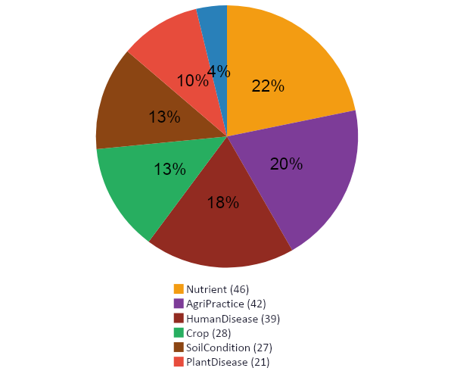
Results Summary: Pipeline Performance
67% of raw tuples passed validation (213/319)
Graph spans all 4 target domains seamlessly
28 unique disease targets identified
Longest chains reach 6 hops across domains
Cancer: 60 paths (highest connectivity)
Cardiovascular & Type-2 Diabetes: 42 paths
Graph grows cumulatively with each new PDF
Key Findings
Node Type Distribution (211 total)

Slide 15
Paper Processed in This Work And Tool Used
Crop health and its global impacts on the components of food security
Exploring the link between soil health and crop productivity
Integrated Soil and Crop Management in Organic Agriculture
The links between agriculture and health
Agronomy-12-02947 — Rice false smut disease analysis
Tools & Libraries
NetworkX (Python graph library)
GraphML / Gephi / Cytoscape / yEd
ChatGPT-5 (OpenAI) for tuple extraction
Gemma-4 (local LLM, Google)

Slide 16
Plan of Work: Next Semester (1/2)
Expand Corpus
Target 15–20 papers across diverse agricultural topics, improving graph coverage and domain breadth
OWL / RDF Export
Add semantic web compatibility — export graph in OWL/RDF format for integration with Linked Open Data
Web Visualization Dashboard
Build an interactive browser-based tool to search by disease and explore the graph visually

Slide 17
Plan of Work: Next Semester (2/2)
Semantic Entity Merging
Implement similarity-based entity merging beyond dictionary normalization to reduce redundancy
Evaluation — Precision/Recall
Benchmark extraction quality against gold-standard annotations for rigorous validation
Ontology Integration
Explore linking the graph with FOODON and Disease Ontology for richer semantic grounding

Slide 18
Conclusions
Successfully built an end-to-end pipeline from scientific PDFs to a reasoning-capable knowledge graph
Discovers non-obvious cross-domain connections between agriculture and human health
ChatGPT-based extraction significantly outperforms local models (71× more paths)
Master graph grows cumulatively with each new PDF — highly scalable
1,141 reasoning paths across 28 disease targets demonstrate practical value for researchers and policymakers

Slide 19
THANK YOU
ANY QUESTIONS?

